Slide 1
Master-Thesis Methodical Approach for Analyzing Process Variables and Optimizing Boundary Conditions in Multi-Axis Robot Programs
Status Update: 8 weeks left
25.12.2023 - 07.01.2024
Jan Nalivaika

Slide 2
Progress
Work in progress
Chapter 1 + Chapter 2 = Doppelt überarbeitet
Chapter 3 = Bessere Einleitung und verständlichere Formulierungen
= Viele Absätze zusammengefasst
= Bilder verbessert
Chapter 4 = Bilder verbessert
= Absätze
Chapter 5 = WIP
Abstract = WIP

Slide 3

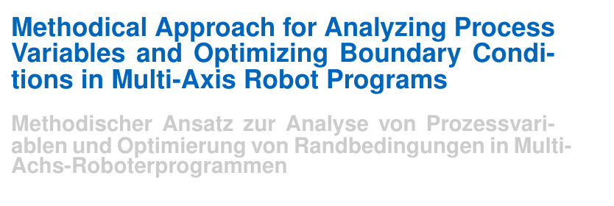
Parameter → Variable
process parameter is a fixed value == Randbedingung
process variable is a measurable quantity = Direction changers
- Titel Änderung
- 1 Kleine Änderung in Aufgabenstellung
- Anpassung in Stand der Technik

Slide 4
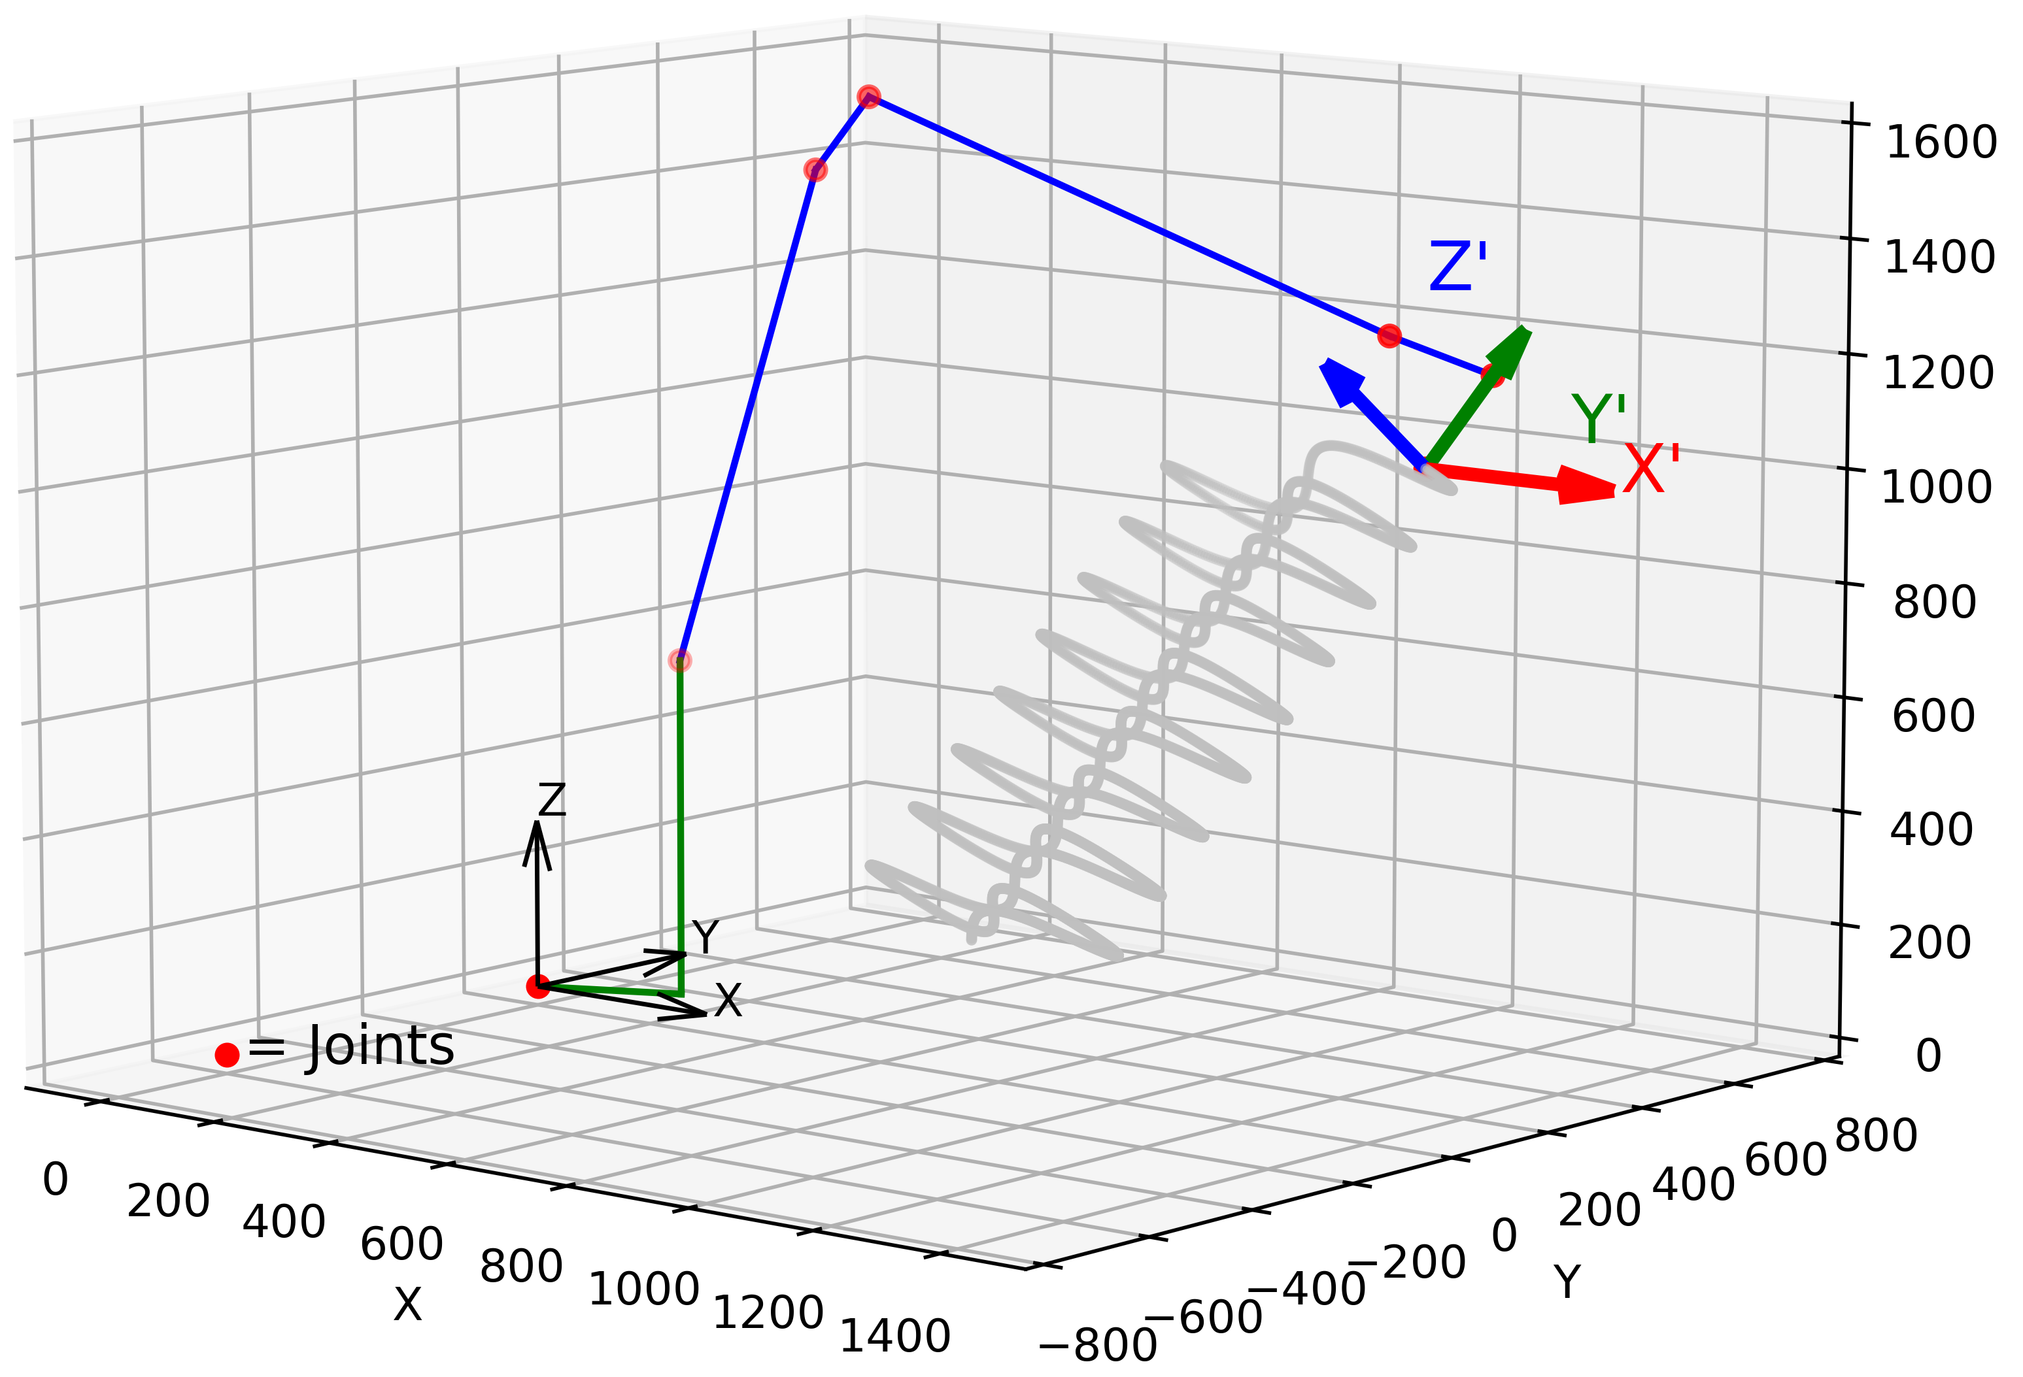
Images

Slide 5
To Do
Email: Titelanpassung ?
Finish Chapters: - Boundary Condition Optimization
- Analysis of the Results
- Discussion of the Results
- Summary
- Abstract
- Outlook
Mittwoch an Ludwig und Marius ☺

Slide 6
Contact
Jan Nalivaika (TUM) Student Otto-Hahn-Ring 6
81739 Munich, Germany
Phone +49 163 7180148
E-mail jan.nalivaika.ext@siemens.com nalivaika@outlook.de
Marius Breuer (Siemens AG)
Supervisor Otto-Hahn-Ring 6
81739 Munich, Germany
Phone +49 (172) 8396287
E-mail marius.breuer@siemens.com
Ludwig Siebert (TUM-IBW)
Supervisor Boltzmannstr. 15
85748 Garching at Munich
Phone +49 (89) 289 – 15578
E-mail ludwig.siebert@iwb.tum.de

Slide 7
Christmas planning
DATE: Ludwig Marius Jan
05.01 ☺ (PDF update)
12.01 ☺
19.01 X
26.01 X
02.02 ☺
09.02 ☺
16.02 ☺
23.02 Last possible Changes in PDF ☺
01.03 Defense ☺

Slide 8
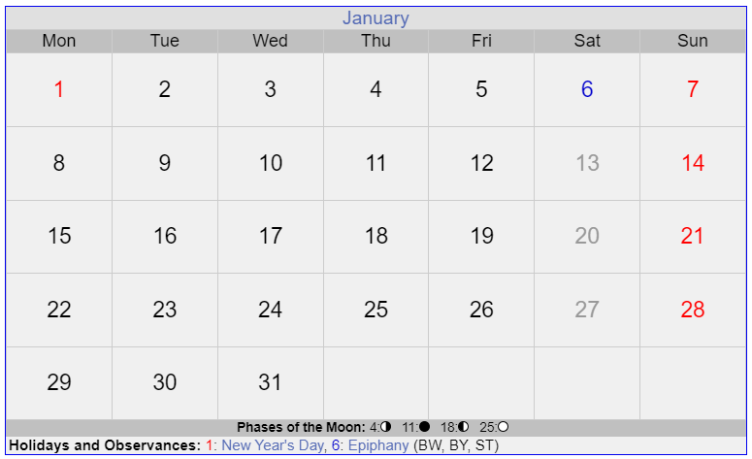

Slide 9
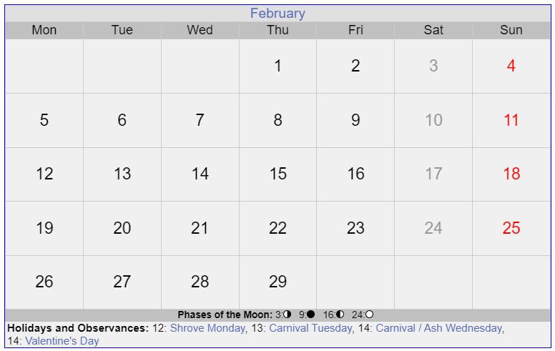

Slide 10
